Slide 1

ADVANCED DATA VISUALIZATION AND REPORTING
SETTING THE STAGE
data-action-lab.com

Slide 2
OUTLINE
Data Visualization with ggplot2
An Introduction to Dashboards

Slide 3
R Graphics
As of 2018, there are 4 graphical systems available in R:
base
grid
lattice
ggplot2
Access to the 4 systems differ: base, grid, lattice are included in the base installation; grid, lattice, ggplot2 have to be loaded explicitly before being used.

Slide 4
A ggplot2 Primer
*not required
ggplot2 is a set of tools that map data to visual display elements, and that allow the user to control the fine details of plot display.
Most important aspect: ggplot2 can be used to think about the logical structure of the plot.
A ggplot2 graph has 2 main components (and optional terms):
aesthetic mappings (aes – connections between data and plot elems.)
plot geometry (geom – specifies the type of plot)
*facets, *coordinates, *scales, *labels, *guides, etc.

Slide 5
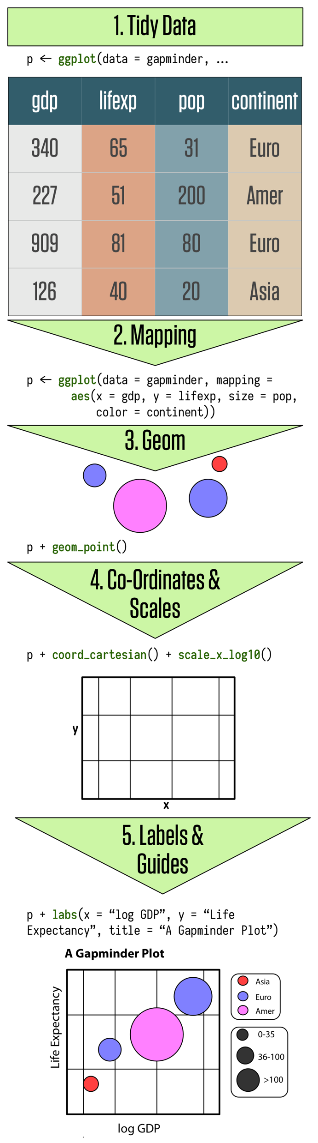
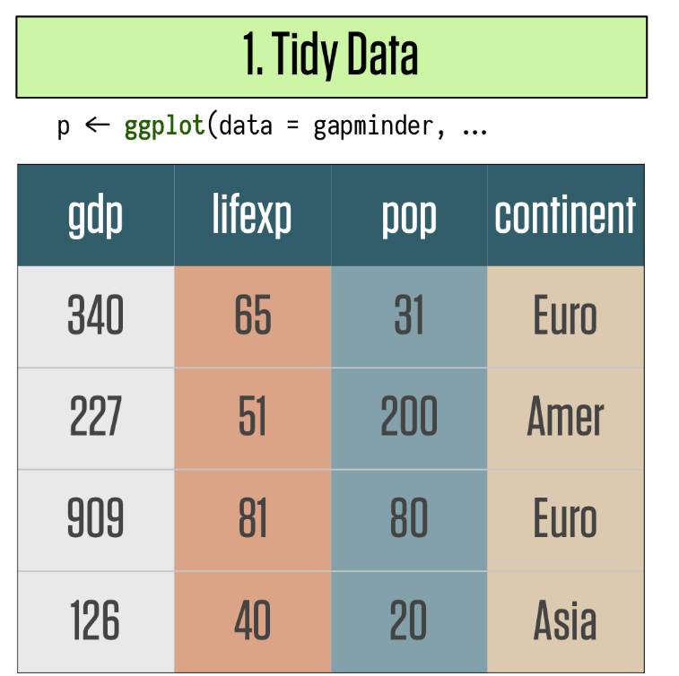
ggplot2 Grammar
[Healey, K., Data Visualization: A Practical Introduction]

Slide 6
ggplot2 Grammar – geoms
The data source and variables to be plotted are specified via ggplot().
The various geom functions specify how these variables are to be visually represented
using points, bars, lines, shaded regions, etc.
There are currently 37 available geoms.

Slide 7
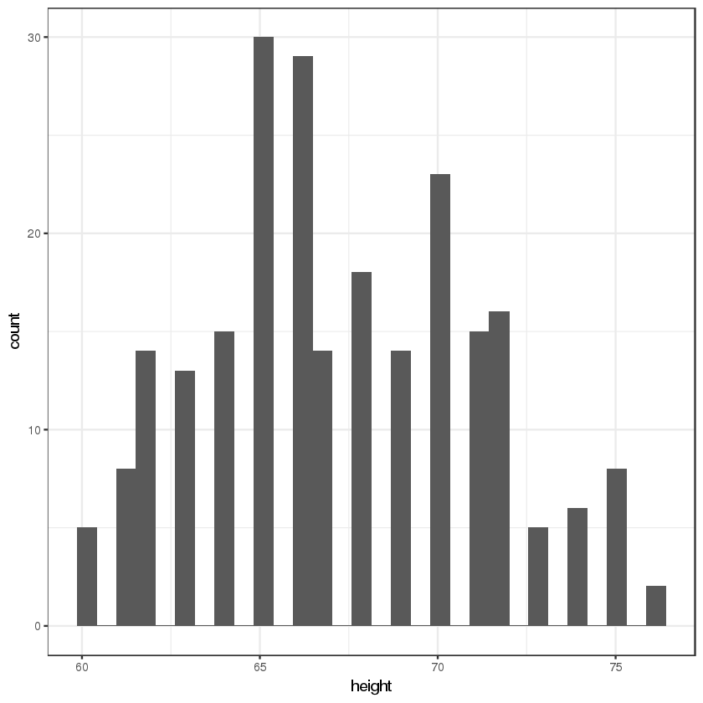
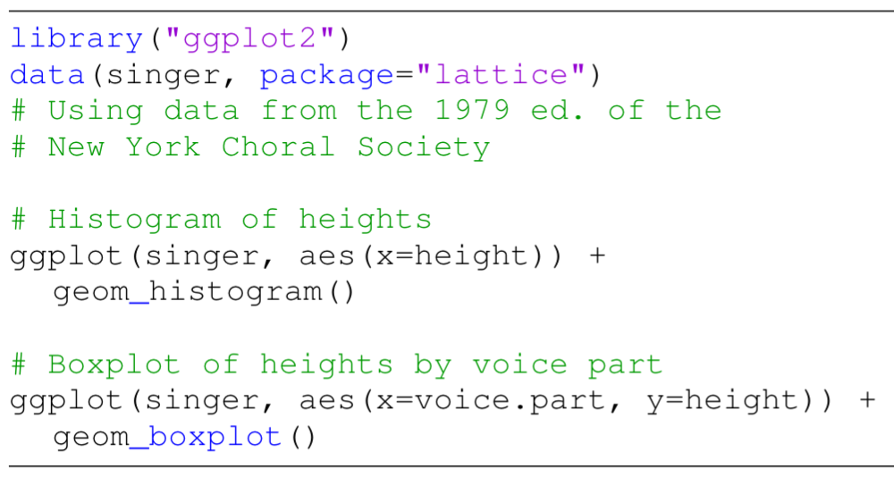
ggplot2 Grammar – geom()

Slide 8
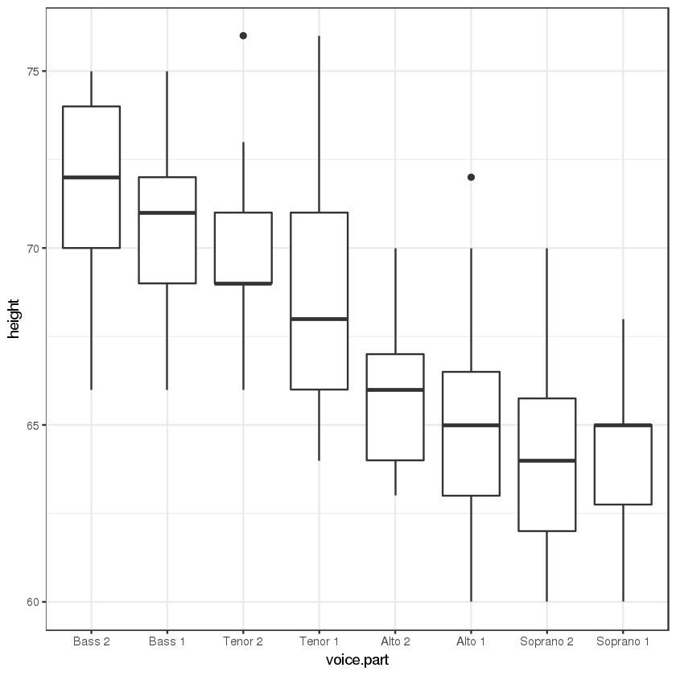
ggplot2 Grammar – geom()

Slide 9
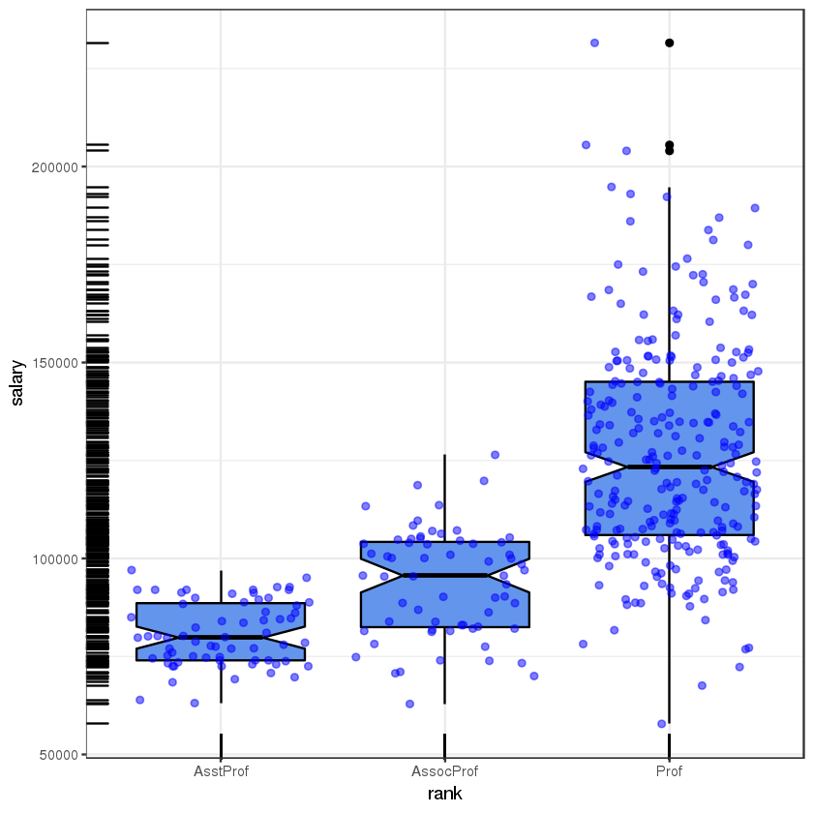
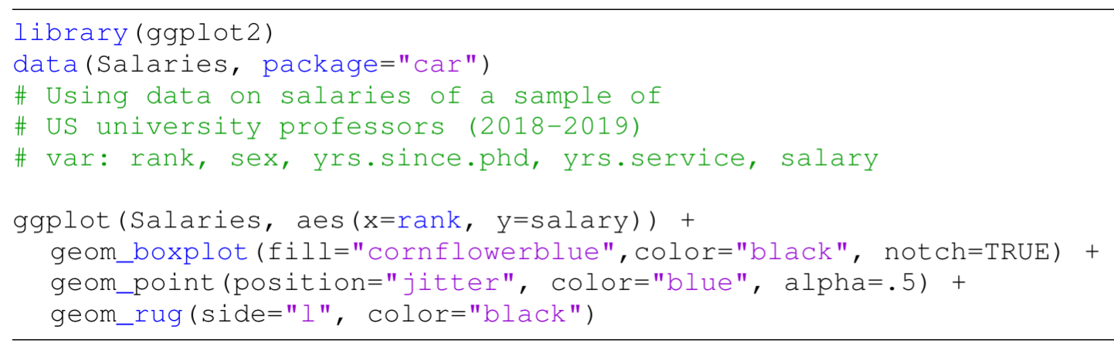
ggplot2 Grammar – geom()

Slide 10
ggplot2 Grammar – aesTHETICS
Aesthetics refer to the displayed attributes of the data.
They map the data to an attribute (such as the size or shape of a marker) and generate an appropriate legend.
Aesthetics are specified with the aes() function.
Aesthetics can be specified within the data function or within a geom. If they’re specified within the data function then they apply to all specified geoms.

Slide 11
ggplot2 Grammar – aesTHETICS
The aesthetics available to geom_point() (scatterplot), as an example, are:
x, y, alpha, color, fill, shape, size
Important difference between specifying characteristics (like colour and shape) inside and outside the aes() function
inside: assigned colour or shape automatically based on the data.
outside: not mapped to data.

Slide 12
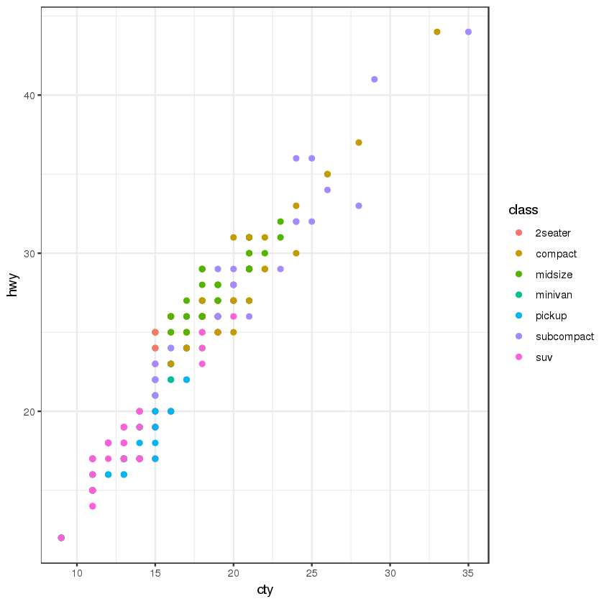
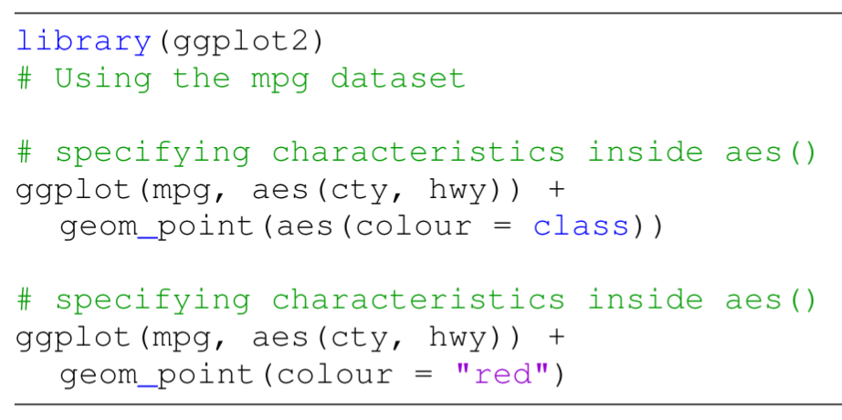
ggplot2 Grammar – aes()

Slide 13
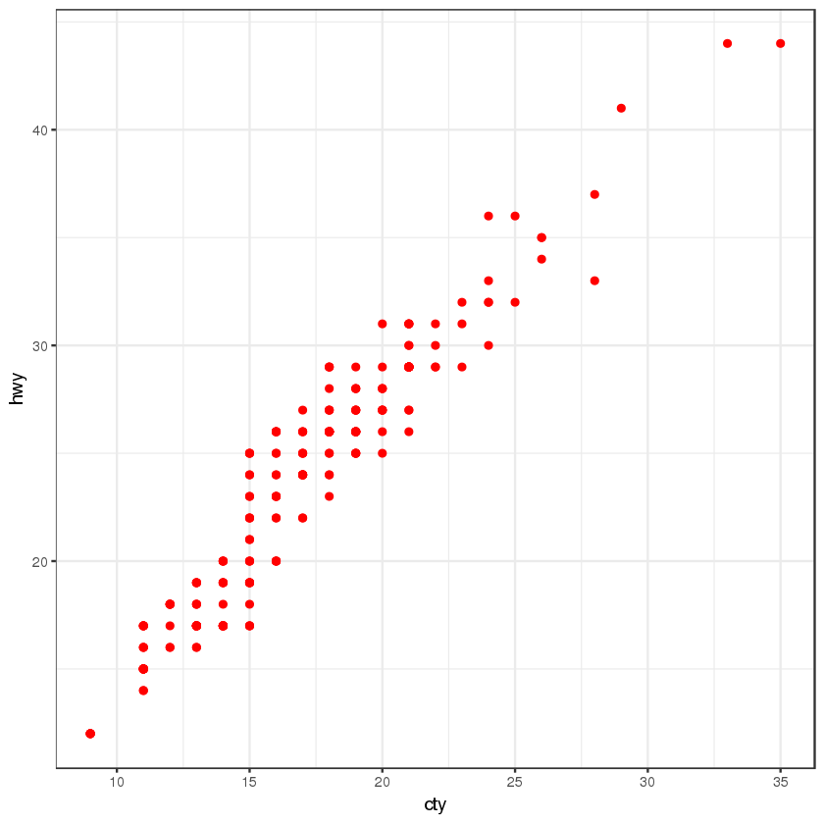
ggplot2 Grammar – aes()

Slide 14
ggplot2 Grammar – facetS
In ggplot2 parlance, small multiples are referred to as facets:
facet_wrap(), facet_grid()
By default, all panels (one for each factor) share the same axes (scale-wise).
Separating the graph into a sequence of smaller, side-by-side plots makes it easier to enact comparisons.

Slide 15
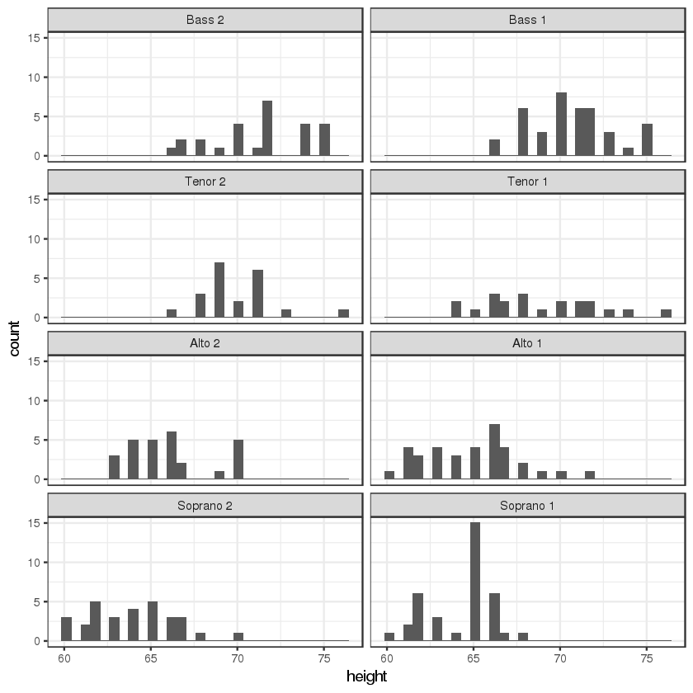
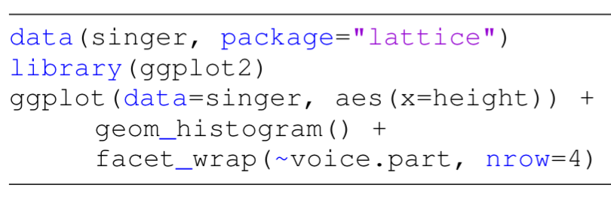
ggplot2 Grammar – facet_WRAP()

Slide 16
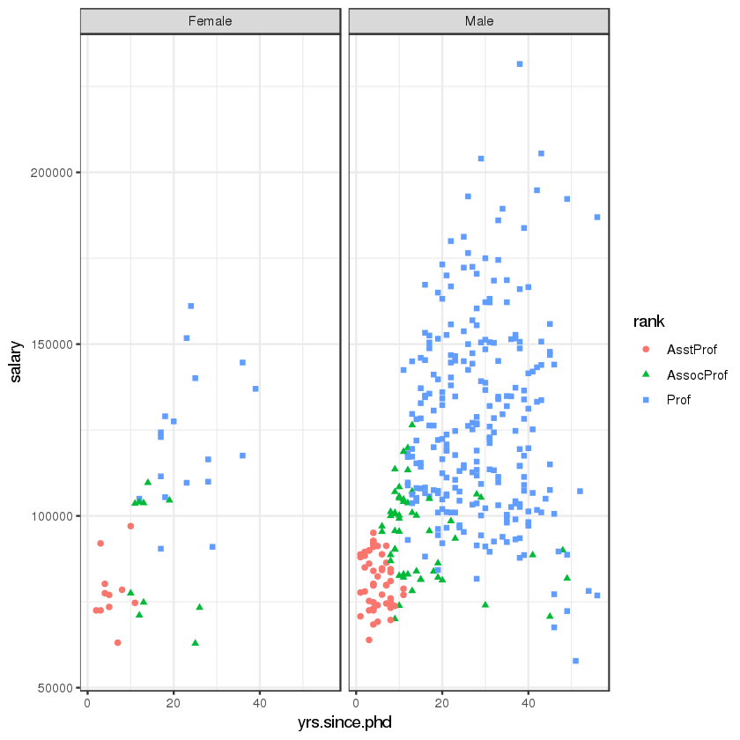
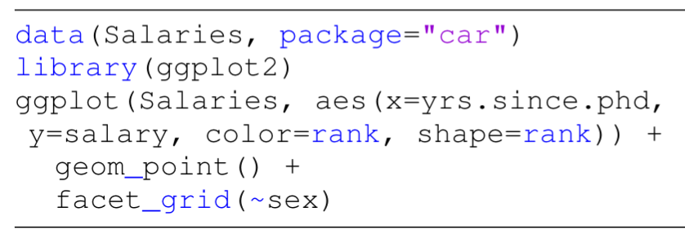
ggplot2 Grammar – facet_GRID()

Slide 17
Reporting and Deployment
An analysis can only be as good as how it is communicated and/or deployed.
Crucial Questions:
Who is in receipt of the report(s)?
How are the workflows deployed into production?
Can data insights be turned into useful policies?
Automatic reporting should be audited and validated regularly.

Slide 18
Reporting and Deployment
Communication should occur at various stages of the project, not solely upon completion:
keep sponsors / clients aware of broad lines
technical details may be avoided, but documented nonetheless
Ideal scenario: analysis software is also reporting software
minimizes human error related to cut-and-paste
removes the need for keeping analysis and reporting separate
makes sharing the work with other project member easier
Simplify the process further by deploying directly to the Web.

Slide 19
Dashboards
[Wexler, Shaffer, Cotgreave, The Big Book of Dashboards]
A dashboard is any visual display of data used to monitor conditions and/or facilitate understanding.
Examples:
interactive display that allows people to explore motor insurance claims by city, province, driver age, etc.
PDF showing key audit metrics that gets e-mailed to a Department’s DG on a weekly basis.
wall-mounted screen that shows call centre statistics in real-time.
mobile app that allow hospital administrators to review wait times on an hourly- and daily-basis for the current year and the previous year.

Slide 20
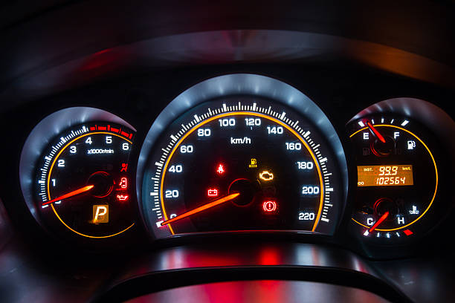
Some Questions To Consider
In a car’s dashboard, a small number of key indicators (speed, gasoline level, lights, etc.) need to be understood at a glance. A dashboard design that does not take these two characteristics under consideration can have catastrophic consequences.
The following questions need to be answered prior to the dashboard being designed:
Who is the dashboard’s consumer?
What story does the dashboard tell?
What data (categories) will be used?
What will appear on the dashboard?
How can the dashboard help the consumer?

Slide 21
DASHBOARD DESIGN Guidelines
[https://www.geckoboard.com/blog/building-great-dashboards-6-golden-rules-to-successful-dashboard-design]
Nick Smith suggests the following 6 Golden Rules:
Consider the audience (who are you trying to inform? does the DG really need to know that the servers are operating at 88% capacity?)
Select the right type of dashboard (operational, strategic/executive, analytical)
Group data logically, use space wisely (split functional areas: product, sales/marketing, finance, people, etc.)
Make the data relevant to the audience (scope and reach of data, different dashboards for different departments, etc.)
Avoid cluttering the dashboard (present the most important metrics only)
Refresh your data at the right frequency (real-time, daily, weekly, monthly, etc. )

Slide 22
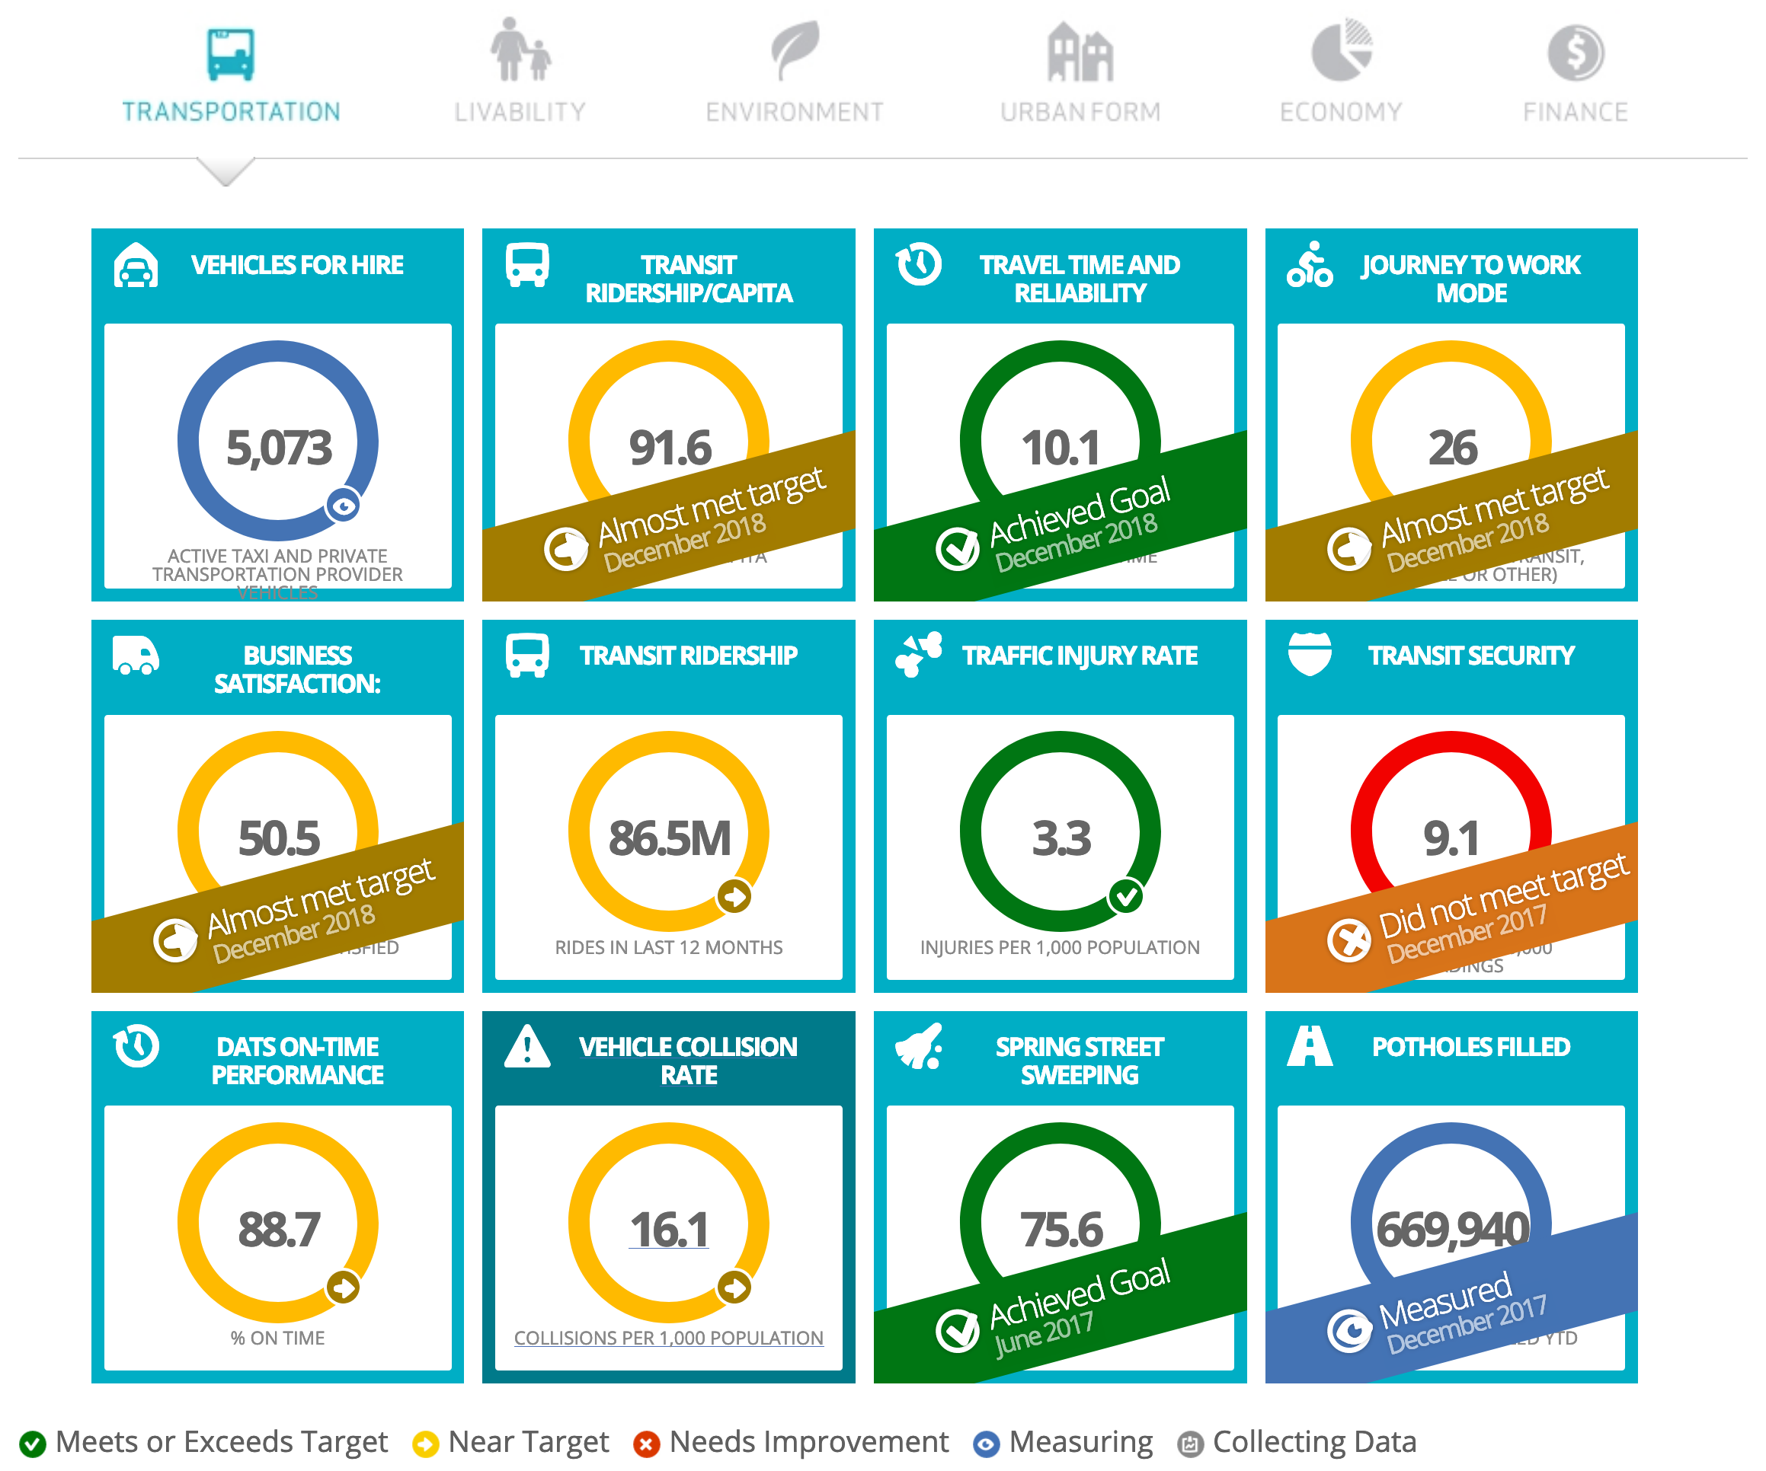
[https://dashboard.edmonton.ca]

Slide 23
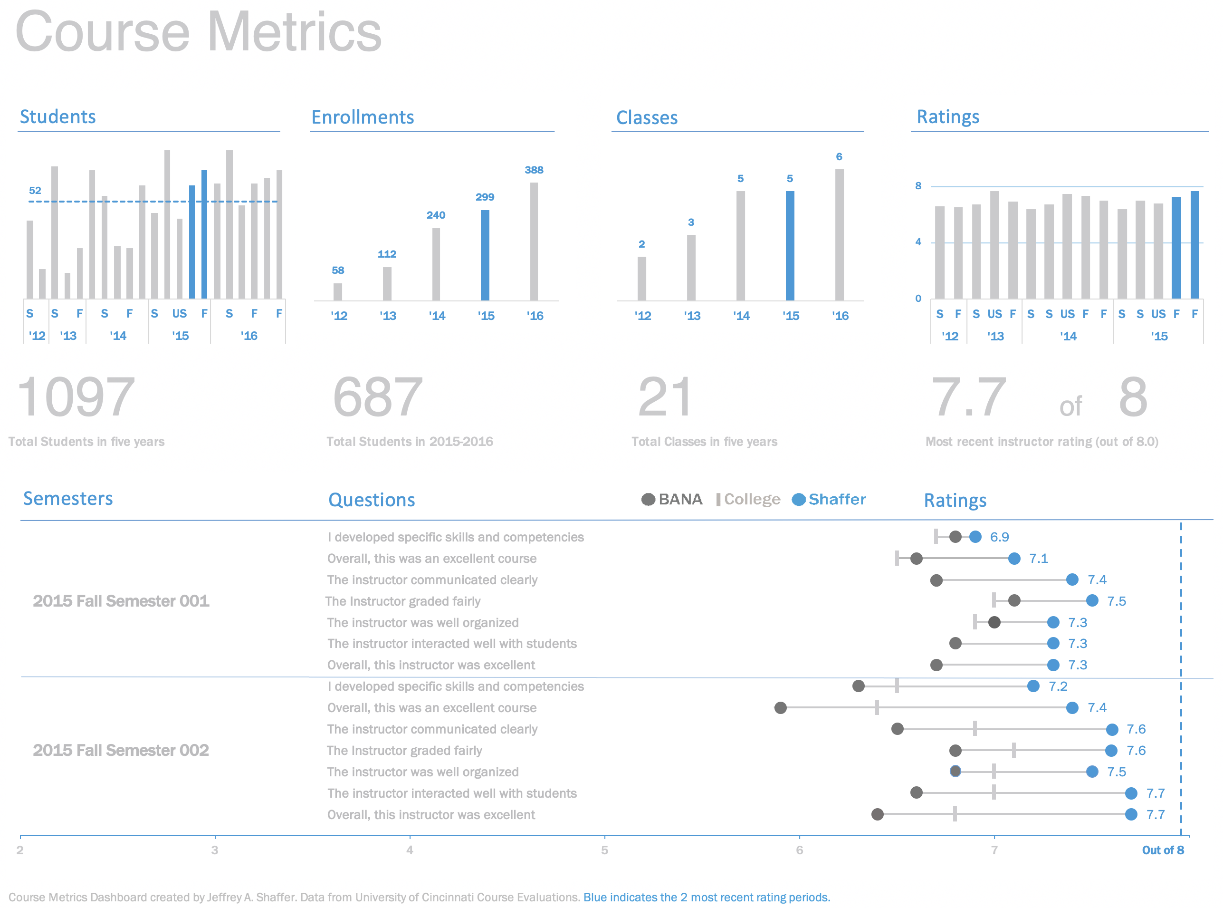
[https://bigbookofdashboards.com/dashboards.html]
Notes:
https://bigbookofdashboards.com/dashboards.html

Slide 24
Course Metrics Dashboard – Strengths
[Wexler, Shaffer, Cotgreave, The Big Book of Dashboards]
Easy-to-see key metrics
Simple color scheme
Potential to be static or interactive
Both overview and details are clear

Slide 25
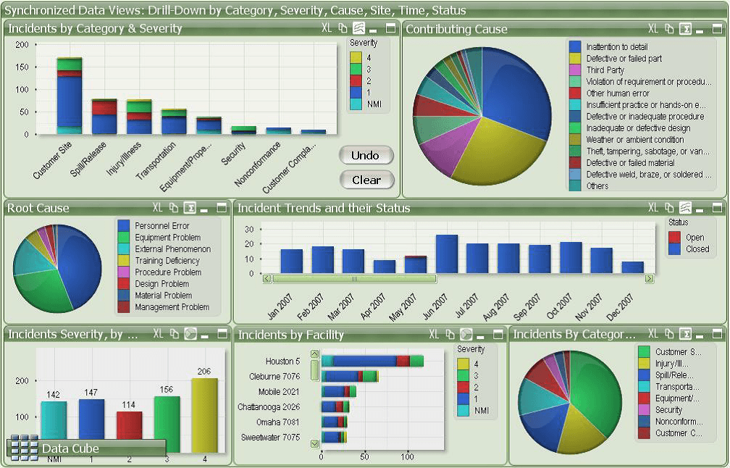
[https://www.matillion.com/wp-content/uploads/2014/11/qlikview-poor-use-of-dashboard-software.png]
Notes:
https://bigbookofdashboards.com/dashboards.html

Slide 26
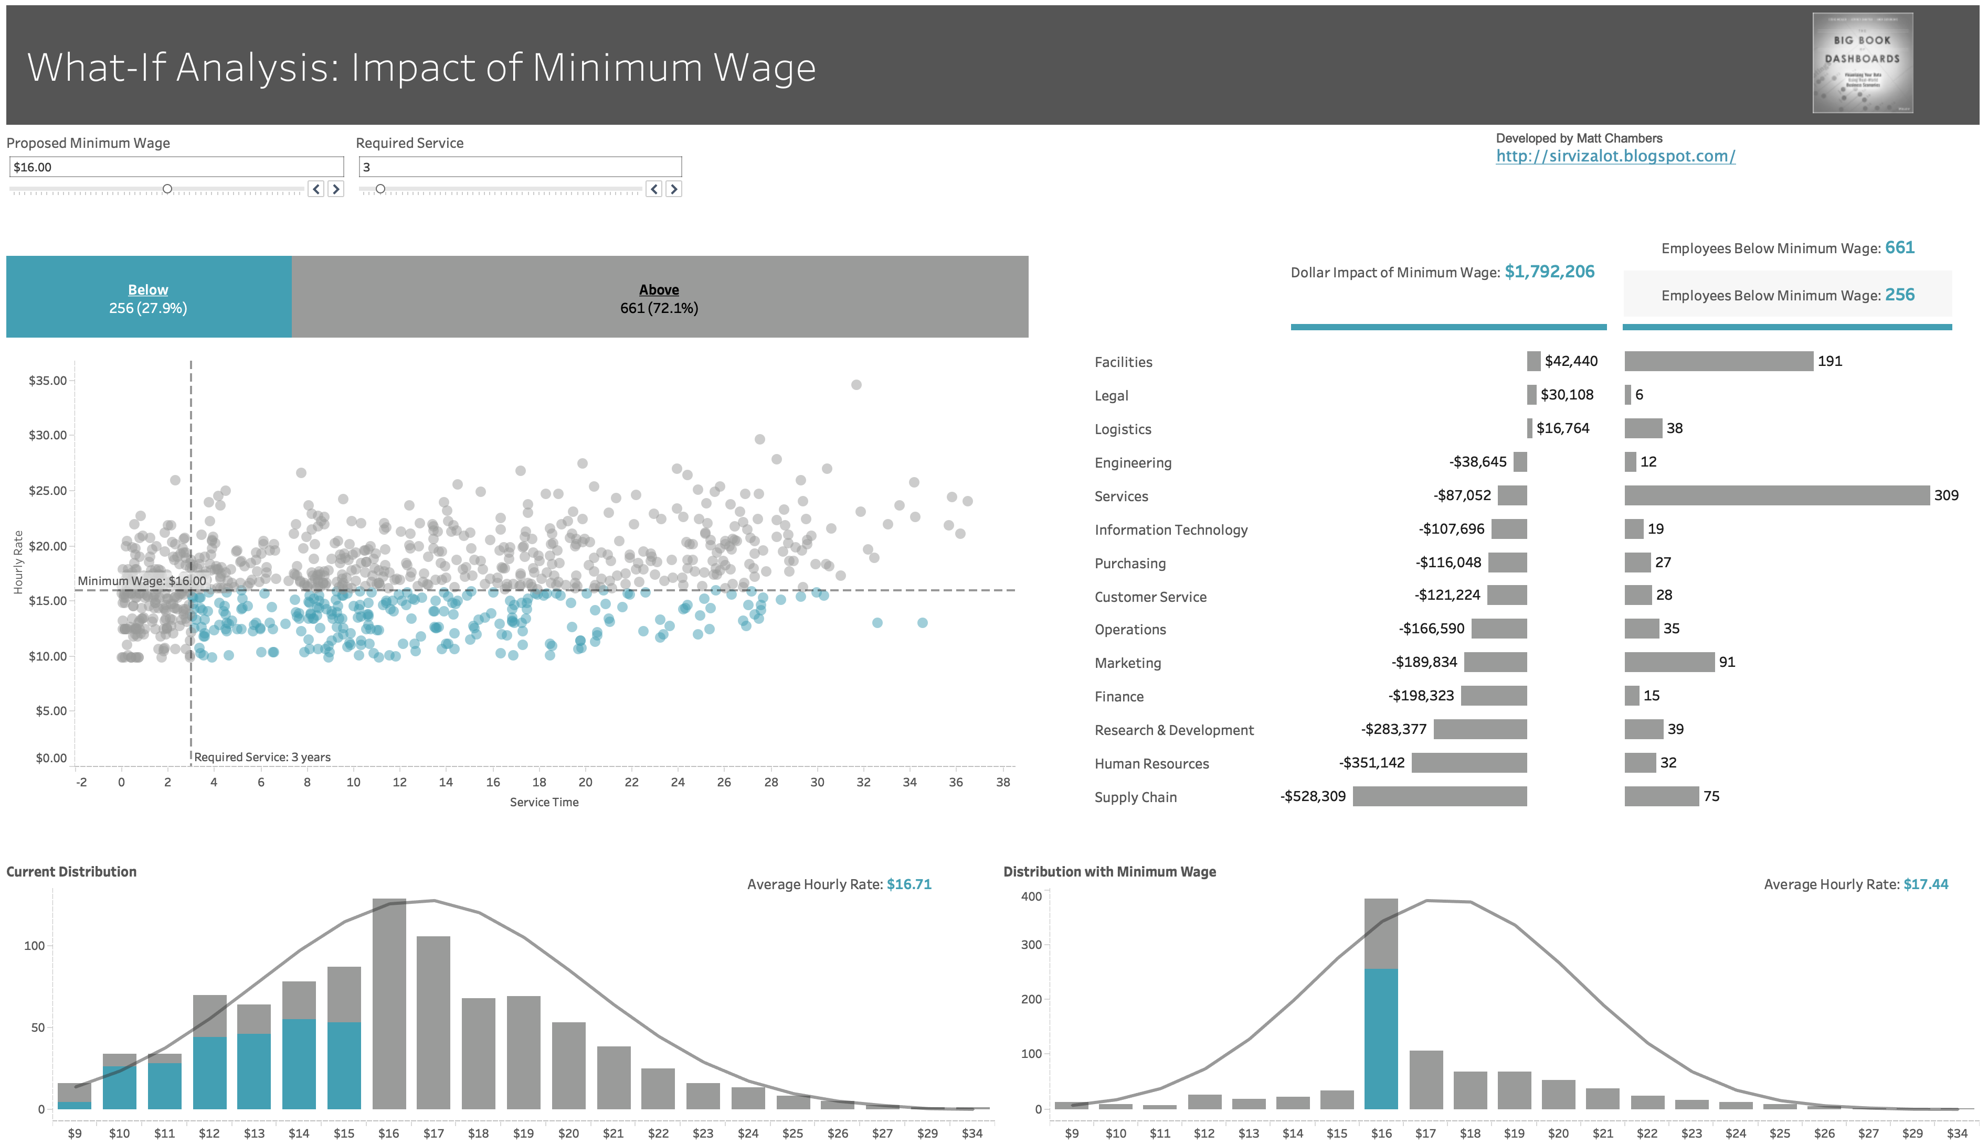
[https://bigbookofdashboards.com/dashboards.html]
Notes:
https://bigbookofdashboards.com/dashboards.html

